Slide 1
US Crime Data Visualization
Abigail Terzis, Amy Qin, Marwa Eltgani, Tracy Lu

Slide 2
Introduction and Motivation
Client: Families interested in moving to large US cities and are concerned with the safety of the surrounding neighborhoods near their perspective areas of work
Goal: Display past crime in areas around LA County and Atlanta
LA data ranges from 2010 - 2017
Each row is a crime reported
Atlanta data ranges from 2009 - 2016
Each row is a crime reported

Slide 3
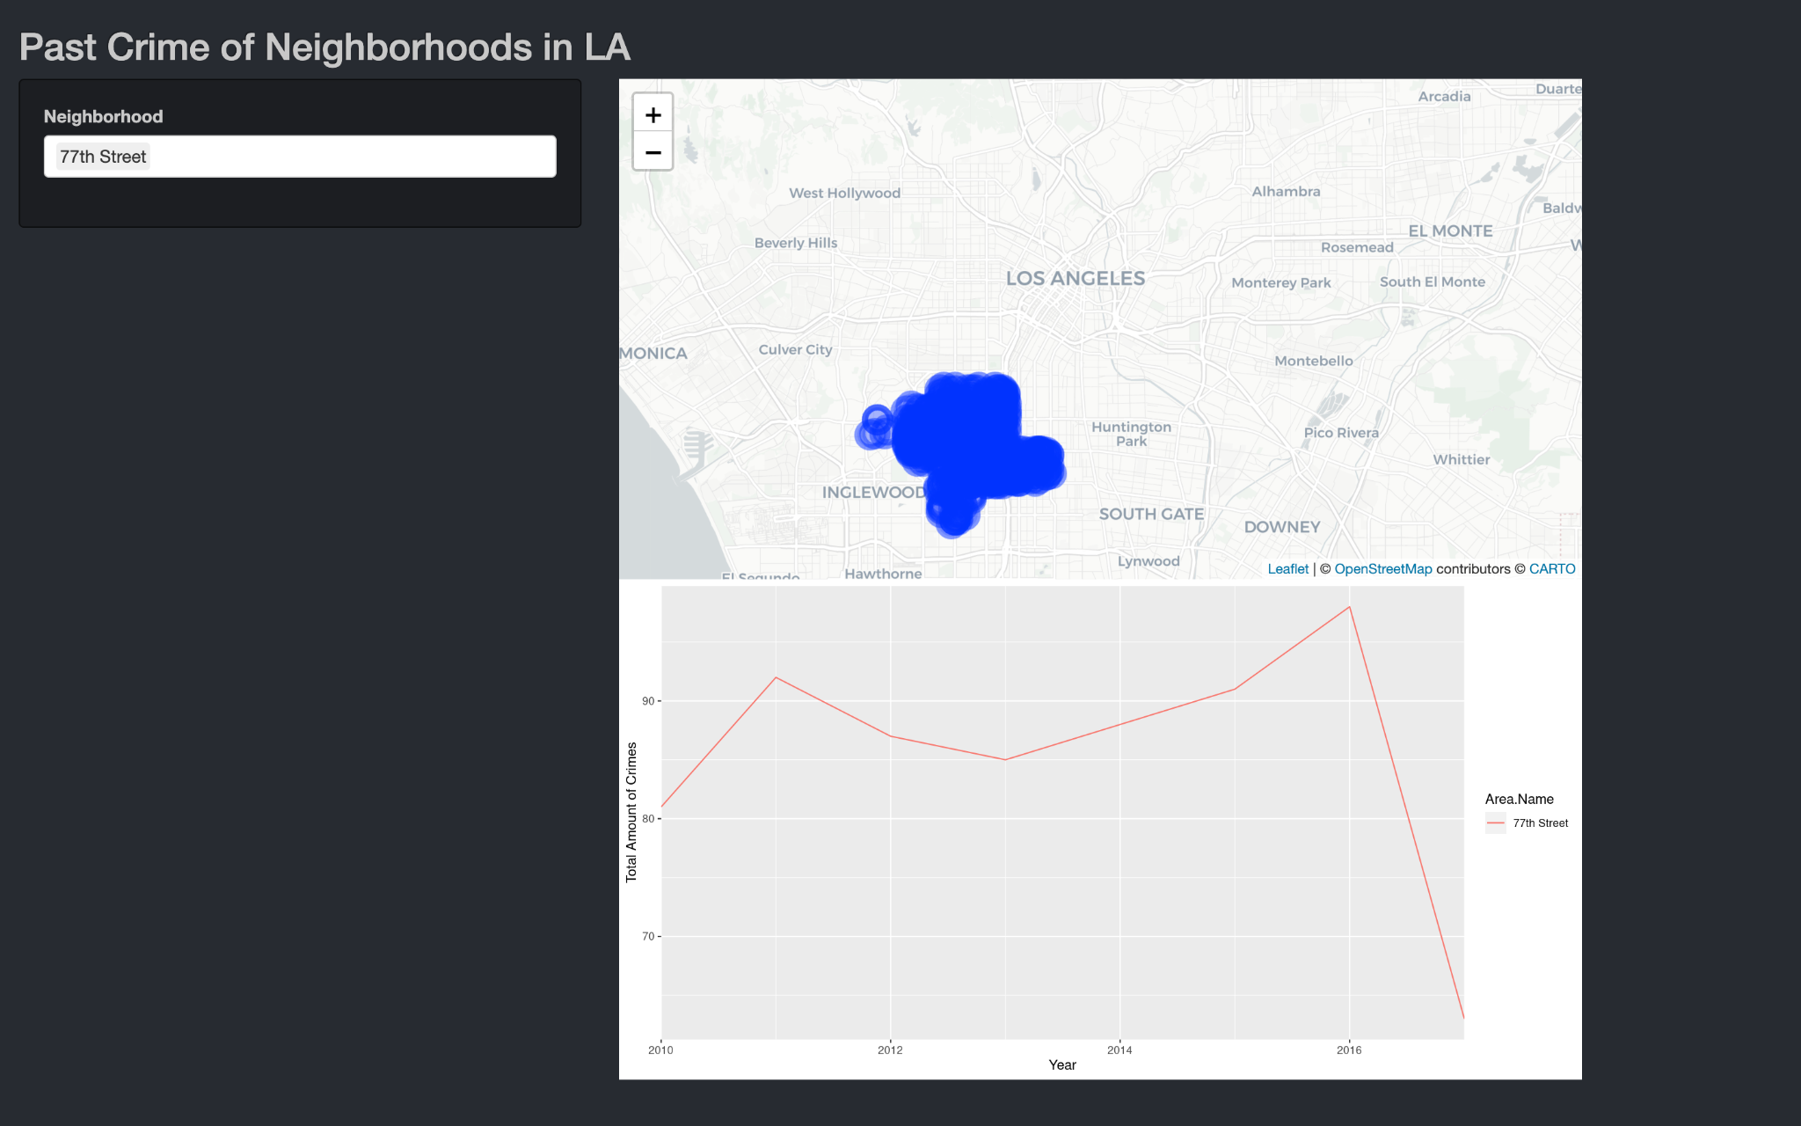
Prototype: LA
Flaws:
Markers, hard to see
Small map, big line graph with extra space
Little information displayed

Slide 4
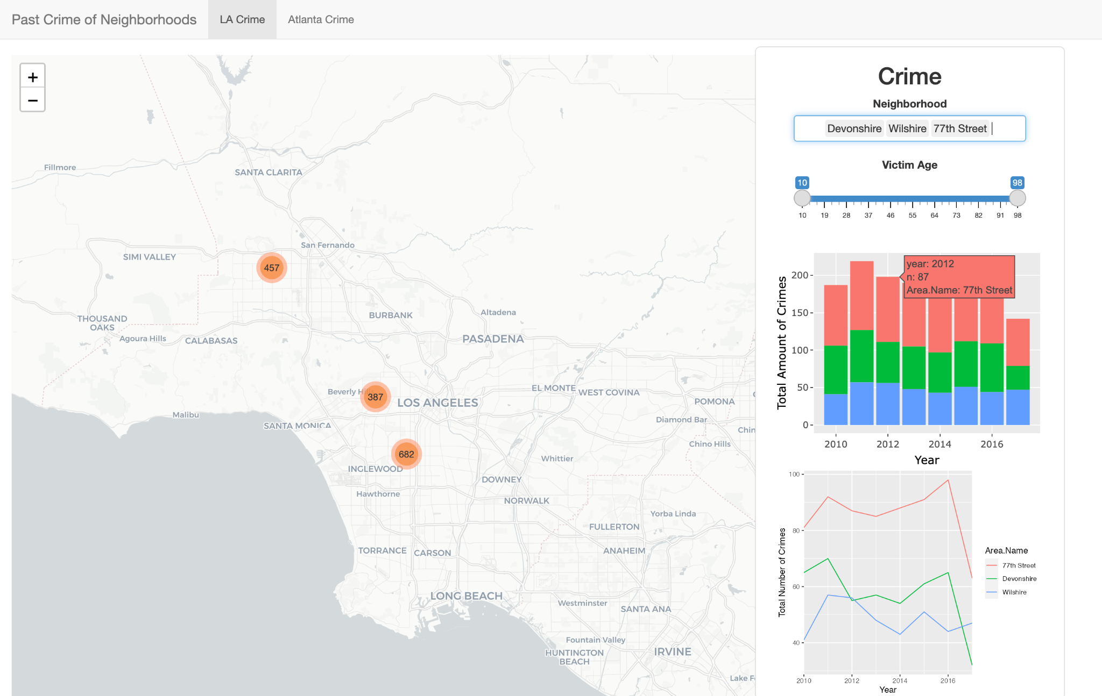
Final Visualization: LA
Improvements:
Added panel that can be moved
Displayed more information
Map is legible, not cluttered

Slide 5
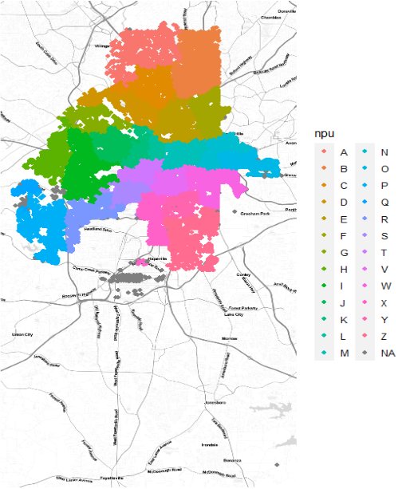
Data Exploration: Atlanta
Type of Crime
Date
Location
Neighborhood Planning Units (NPU)
Neighborhood
Address
Coordinates

Slide 6
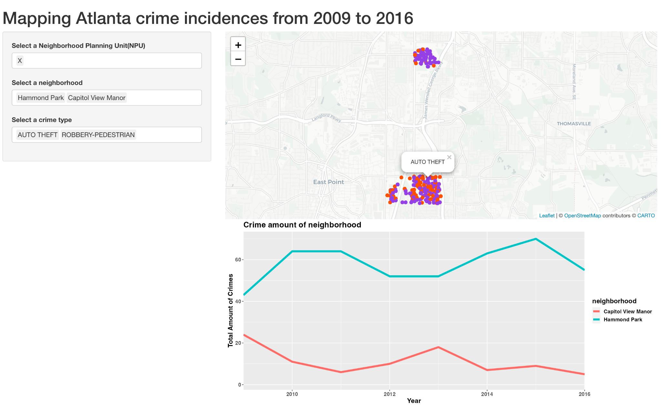
Atlanta crime data visualization

Slide 7
Shiny App
Link to Shiny App
Github link: code for final Shiny app can be found in the final_LA_Atl.R file

